Slide 1
Searching and Sorting

Slide 2
Searching and Sorting:
We have learned that in order to write a computer program which performs some task we must construct a suitable algorithm.
However, whatever algorithm we construct is unlikely to be unique – there are likely to be many possible algorithms which can perform the same task.
Are some of these algorithms in some sense better than others?
Algorithm analysis is the study of this question.

Slide 3
Searching and Sorting:
In this chapter we will analyze the:
Searching – finding the position of a value within a list.
Searching is a process of finding a element among several given elements.
The search is successful if the required element is found.
Otherwise, the search is unsuccessful.
Sorting – Ordering a list of values.

Slide 4
Linear Search:
The linear search is the algorithm of choice for short lists, because it’s simple and requires minimal code to implement.
The linear search algorithm looks at the first list item to see whether you are searching for it and, if so, you are finished.
If not, it looks at the next item and on through each entry in the list.

Slide 5
How does it work:
Linear search is the basic search algorithm used in data structures.
It is also called as sequential search.
Linear search is used to find a specific element in an array.
It is not compulsory to arrange an array in any order (Ascending or Descending) as in the case of binary search.

Slide 6
Algorithm:
start with a list of numbers, say 10 of them
First, we will ask for a number we think may be in the list. We will call this variable ''searchItem''
Also, we will set a flag variable called ''found'' to false
Now loop thru the entire list from start to end
Compare the item at the current position in the list with ''searchItem''
If it matches then set ''found'' to true and exit the loop, else move on to the next position
Otherwise, if we have searched the entire list, ''searchItem'' was not found, so ''found'' remains false

Slide 7
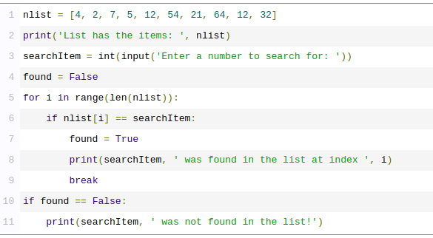
Implementation:

Slide 8
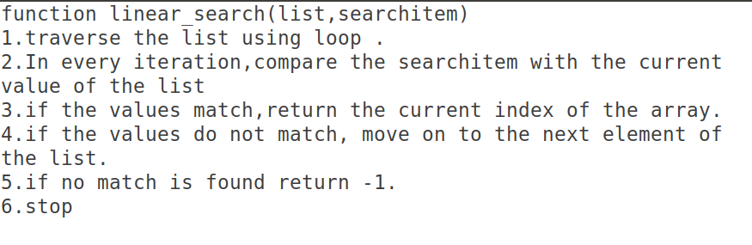
Using Modularity:

Slide 9
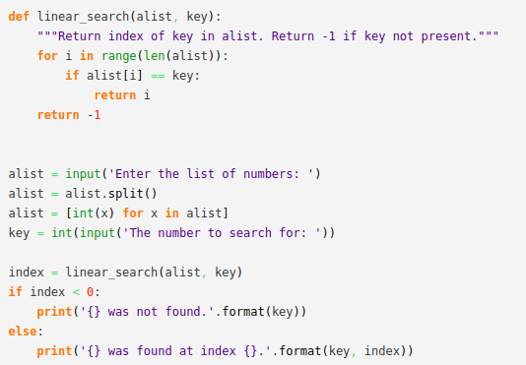
Implementation (modularity):

Slide 10
Binary Search:
Binary Search is one of the most fundamental and useful algorithms in Computer Science. It describes the process of searching for a specific value in an ordered collection.
This search is more complicated than the linear search but for large databases it’s much faster than a linear search.
It works on the principle of divide and conquer technique.
This algorithm can be used when the list has terms occurring in order of increasing size

Slide 11
How does it work:
In its simplest form, Binary Search operates on a contiguous sequence with a specified left and right index. This is called the Search Space.
Binary Search maintains the left, right, and middle indices of the search space and compares the search target or applies the search condition to the middle value of the collection.
If the condition is unsatisfied or values unequal, the half in which the target cannot lie is eliminated and the search continues the remaining half until it is successful.
If the search ends with an empty half, the condition cannot be fulfilled, and target is not found.

Slide 12
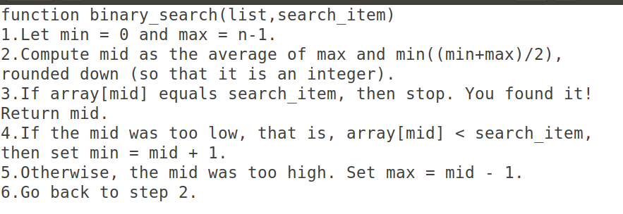
Algorithm:

Slide 13
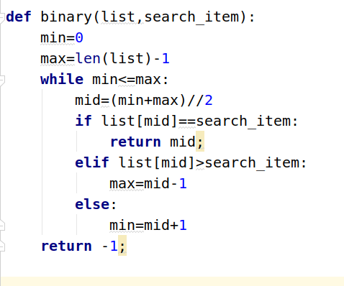
Implementation:
Iterative approach

Slide 14
Questions:
Task –1. Write an algorithm of binary search using recursive approach.
Task-2. Implement the above algorithm using Python code.
Task-3. Find out the Time Complexity of above algorithm.
Link:https://codeburst.io/algorithms-i-searching-and-sorting-algorithms-56497dbaef20
Link:https://www.w3resource.com/python-exercises/data-structures-and-algorithms
Link:https://www.geeksforgeeks.org/python-program-for-binary-search/

Slide 15
Sorting:
Sorting refers to arranging data in particular format. Sorting algorithm specifies the way to arrange data in a particular order.
The importance of sorting lies in the fact that data searching can be optimized to a very high level, if data is stored in a sorted manner. Sorting is also used to represent data in more readable formats. Below we see five such implementations of sorting in python.
Bubble Sort
Merge Sort
Insertion Sort
Shell Sort
Selection Sort

Slide 16
Bubble Sort:
It is a comparison-based algorithm in which each pair of adjacent elements is compared, and the elements are swapped if they are not in order.
The simplest form of sorting is known as the bubble sort.
It requires us to step over the whole array several times.

Slide 17
How does it work:
We begin by comparing the first two elements of the list.
If the first element is larger than the second element, we swap them.
If they are already in order, we leave them as it is.
We then move to the next pair of elements, compare their values and swap, as necessary.
This process continues to the last pair of items in the list.

Slide 18
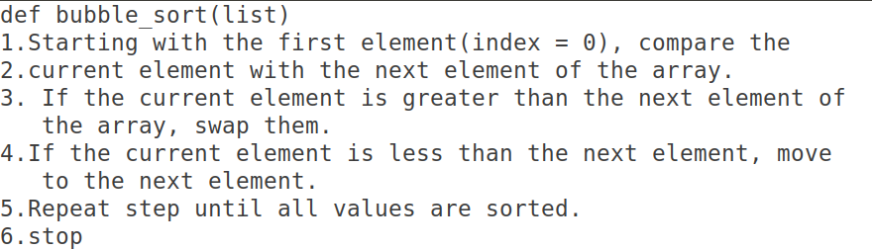
Algorithm:

Slide 19
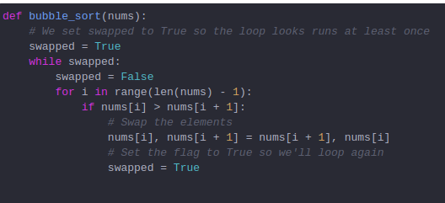
Implementation:

Slide 20
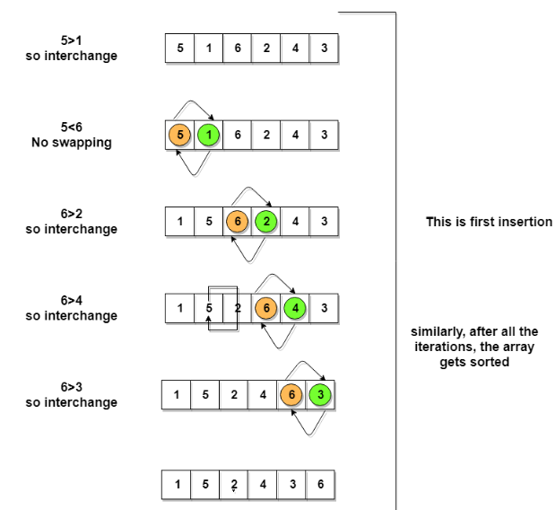
Example:
1st iteration

Slide 21
Selection Sort:
Selection sort is one of the simplest sorting algorithms.
It is like the hand picking where we take the smallest element and put it in the first position and the second smallest at the second position and so on.
It is also similar. We first check for smallest element in the list and swap it with the first element of the list.
Again, we check for the smallest number in a sublist, excluding the first element of the list as it is where it should be (at the first position) and put it in the second position of the list. We continue repeating this process until the list gets sorted.
The time complexity of selection sort is (O(n²)).

Slide 22
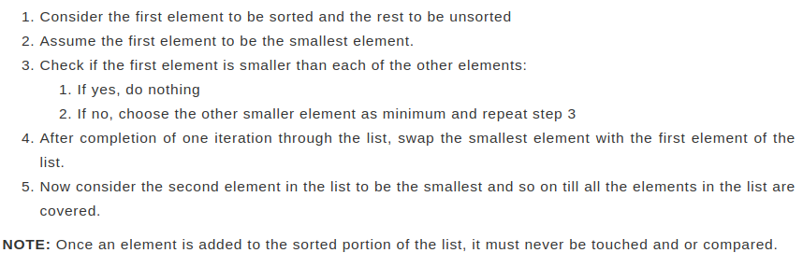
Algorithm:

Slide 23
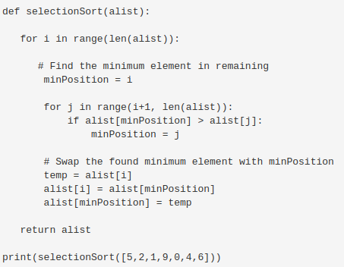
Implementation:

Slide 24
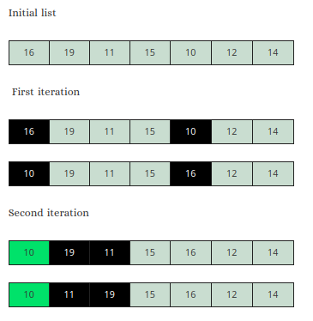
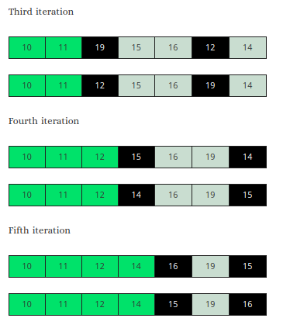
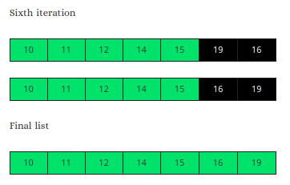
Example:

Slide 25
Resource Link:
https://www.pythoncentral.io/selection-sort-implementation-guide/
https://www.pythoncentral.io/series/python-data-structures-tutorial/

Slide 26
Insertion Sort:
As the name suggests, in Insertion Sort, an element gets compared and inserted into the correct position in the list.
To apply this sort, you must consider one part of the list to be sorted and the other to be unsorted.
To begin, consider the first element to be the sorted portion and the other elements of the list to be unsorted.
Now compare each element from the unsorted portion with the element/s in the sorted portion. Then insert it in the correct position in the sorted part.
Remember, the sorted portion of the list always remain sorted .

Slide 27
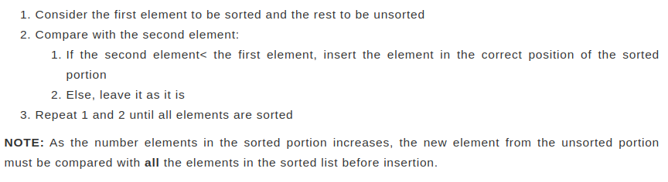
Algorithm:

Slide 28
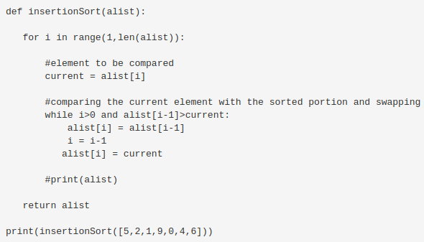
Implementation:

Slide 29
Merge Sort:
Merge sort is a sorting technique based on divide and conquer technique.
With worst-case time complexity being Ο(n log n), it is one of the most respected algorithms.
Merge sort first divides the array into equal halves and then combines them in a sorted manner.

Slide 30
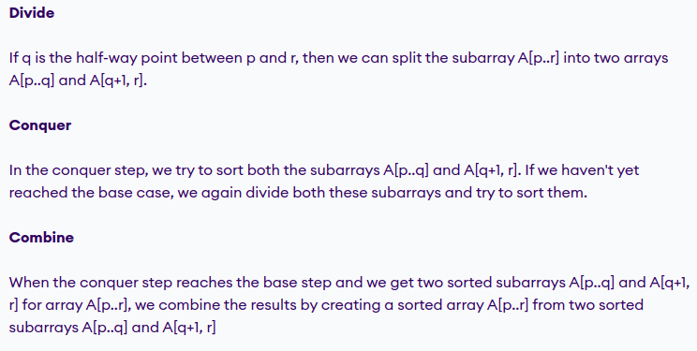

Slide 31

Algorithm:

Slide 32
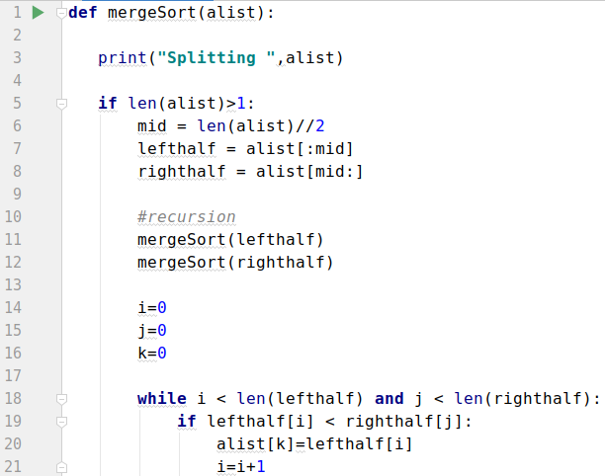
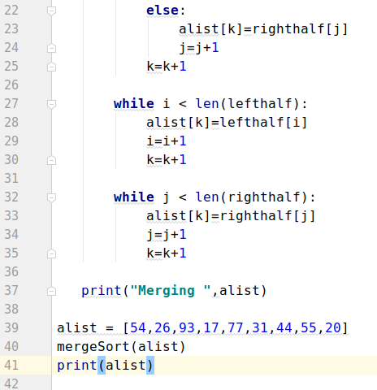
Implementation:

Slide 33
Resource Link:
Link1:https://www.pythoncentral.io/merge-sort-implementation-guide/
Link2:https://www.programiz.com/dsa/merge-sort

